Slide 1
2020-21 Annual Retirement Celebration

Slide 2
Jeanne Annunziato 13 Years of Service
Special Education Para
Hidden Hills Elementary School

Slide 3
Katherine Apodaca 28 Years of Service
Library Media Coordinator
Country Club Elementary School

Slide 4
Becca Bartolone 21 Years of Service
School Office Manager
Pine Valley Middle School

Slide 5
Jon Berke 19 Years of Service
Teacher
Diablo Vista Middle School

Slide 6
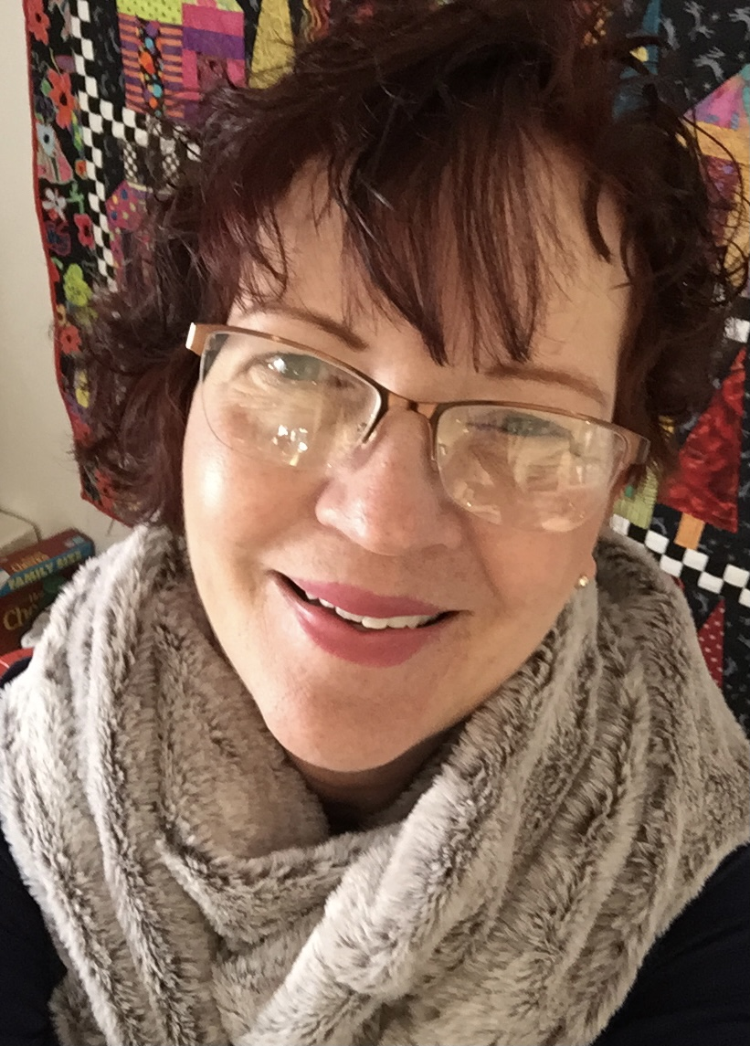
Sharon Brown 22 Years of Service
Teacher
Bella Vista Elementary School

Slide 7
Lori Carson 17 Years of Service
Teacher
Monte Vista High School

Slide 8
Anne Cherniss-Cooke 19 Years of Service
Speech Language Pathologist Assistant
Montair Elementary/Dougherty Valley High School

Slide 9
Cammie Clowdsley 22 Years of Service
School Office Manger
Iron Horse Middle School

Slide 10
Colonel Davis 14 Years of Service
Teacher
Windemere Ranch Middle School

Slide 11
Penelope Davis 14 Years of Service
Teacher
San Ramon Valley High School

Slide 12
Azalea De La Garza 9 Years of Service
Bus Driver
Transportation Department

Slide 13
Shauna De Silva 20 Years of Service
Teacher
Iron Horse Middle School

Slide 14
Pat Dowling 22 Years of Service
Teacher
Monte Vista High School

Slide 15
Lynn Fernandez 28 Years of Service Teacher
Monte Vista High School

Slide 16
Susan Fitch 22 Years of Service
Counselor
California High School

Slide 17
Jean Galeste 14 Years of Service
Autism Specialist Para
Dougherty Valley High School

Slide 18
Nancy Gamache 6 Years of Service
Director
Human Resources Department

Slide 19
Kimberley Gilles 15 Years of Service
Teacher
Monte Vista High School

Slide 20
Greta Hayton 32 Years of Service
Classroom Para
Rancho Romero Elementary School

Slide 21
Janice Hildreth 9 Years of Service
School Office Assistant
Alamo Elementary School

Slide 22
Eileen Hock 28 Years of Service
Library Media Coordinator
Montevideo Elementary School

Slide 23
Scott Hodges 23 Years of Service
Teacher
California High School

Slide 24
Rose Hyrn 14 Years of Service
School Office Assistant
Live Oak Elementary School

Slide 25
Sandra Isbell 31 Years of Service
Teacher
Monte Vista High School

Slide 26
Kathy Karp 20 Years of Service
Resource Teacher
Windemere Ranch Middle School

Slide 27
Anne Katzburg 23 Years of Service
SRVEA President

Slide 28
Janet Kaye 16 Years of Service
Classroom Para
Rancho Romero Elementary School

Slide 29
Deborah Keesling 3 Years of Service
Resource Teacher
California High School

Slide 30
John Krisman 10 Years of Service
Bus Driver
Transportation Department

Slide 31
Vinh Lam 20 Years of Service
Custodian
Coyote Creek Elementary School

Slide 32
Barbara Lee 11 Years of Service
Bus Driver
Transportation Department

Slide 33
Carrie Lehman-Wilson 31 Years of Service
Teacher
Vista Grande Elementary School

Slide 34
Rosa Lopez 14 Years of Service
Payroll Technician
Payroll Department

Slide 35
Linda Mailho 28 Years of Service
Library Media Coordinator
Rancho Romero Elementary School

Slide 36
Rick Meyers 14 Years of Service
Warehouse Worker/Delivery Driver
Warehouse Department

Slide 37
Tanya Meyers 14 Years of Service
Executive Secretary
Special Education Department

Slide 38
Wendy Miller 20 Years of Service
Registrar
California High School

Slide 39
Cathy Muse 21 Years of Service
Special Ed Teacher
Diablo Vista Middle School

Slide 40
Hoa Ngo 20 Years of Service
Custodian
Monte Vista High School

Slide 41
Shari Noda 20 Years of Service
Teacher
Twin Creeks Elementary School

Slide 42
Aileen Parsons 2 Years of Service
Director
Human Resources Department

Slide 43
Marypat Prince 9 Years of Service
Secretary I
Dougherty Valley High School

Slide 44
Mariane Randall 17 Years of Service
Teacher
Hidden Hills/Live Oak Elementary School

Slide 45
Jeannie Range 28 Years of Service
School Office Manager
Tassajara Hills Elementary School

Slide 46
Kathy Saca 22 Years of Service
Resource Teacher
Monte Vista High School

Slide 47
Evelyn Safari 13 Years of Service
Autism Specialist Para
Country Club Elementary School

Slide 48
David Santos 13 Years of Service
Teacher
San Ramon Valley High School

Slide 49
Dennis Saunders 10 Years of Service
Custodian
Windemere Ranch Middle School

Slide 50
Kelly Scanlon 14 Years of Service
Teacher
Quail Run Elementary School

Slide 51
Jill Schratz 12 Years of Service
College & Career Coordinator
San Ramon Valley High School

Slide 52
Holly Scott 17 Years of Service
Teacher
Montair Elementary School

Slide 53
Cindy Seip 17 Years of Service
Executive Secretary
Buildings & Grounds Department

Slide 54
Cindy Sexton 24 Years of Service
Classroom Para
Coyote Creek Elementary School

Slide 55
Ursula Sexton 6 Years of Service
Teacher
Montevideo Elementary School

Slide 56
Allen Shotwell 23 Years of Service
Teacher
Monte Vista High School

Slide 57
Trish Slomowitz 17 Years of Service
Teacher
Stone Valley Middle School

Slide 58
Yvonne Spilker 38 Years of Service
Teacher
Monte Vista High School

Slide 59
Kim Tatum 19 Years of Service
Library Media Coordinator
Live Oak Elementary School

Slide 60
Rose Tishler 23 Years of Service
Teacher
Country Club Elementary School

Slide 61
Cynthia Tria 24 Years of Service
Teacher
Monte Vista High School

Slide 62
Annie Vargas 16 Years of Service
Teacher
Pine Valley Middle School

Slide 63
Tomoko Vinck 16 Years of Service
Child Nutrition Assistant
California High School

Slide 64
Jillian Wald 14 Years of Service
Teacher
Montevideo Elementary School

Slide 65
Pam Ward 18 Years of Service
Senior Buyer
Purchasing Department

Slide 66
Leslie Wostenberg 21 Years of Service
Autism Specialist Para
Golden View Elementary School

Slide 67
Congratulatory words from Superintendent Malloy & Board President Susanna Ordway.

Slide 68
Congratulations on your retirement! Thank you for the many contributions you have made in the lives of the students and staff of the San Ramon Valley Unified School District.

